Slide 1
To Whom Go the Spoils? Exploring 4,000 Years of Victory & Defeat
Sean Clark
Ph.D Candidate, Dalhousie University
Doctoral Fellow, CFPS
sean.clark@dal.ca
web.me.com/sean_m_c
Dissertation Defence Presentation, 2011

Slide 2
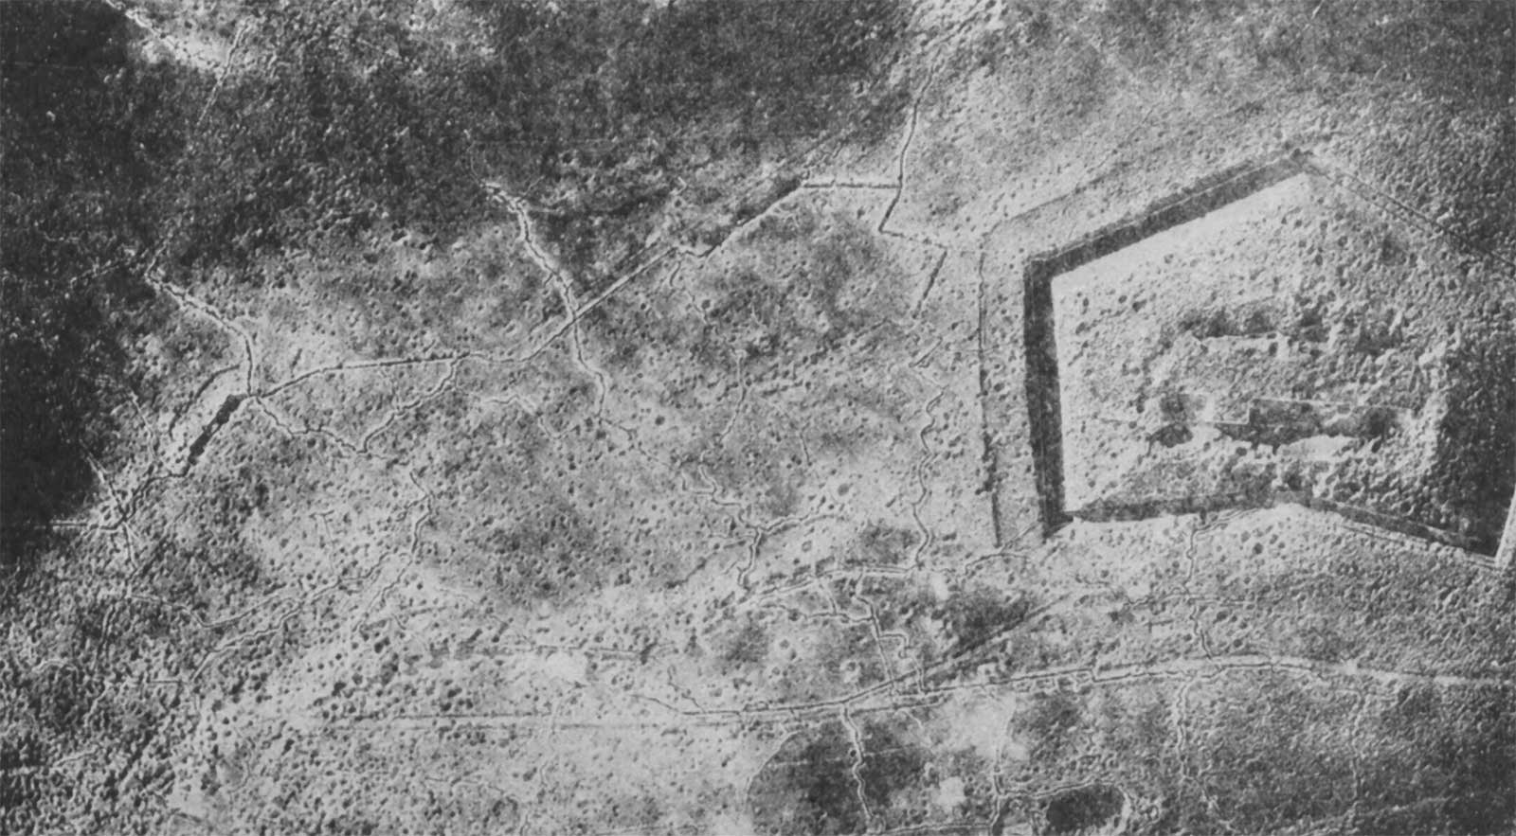
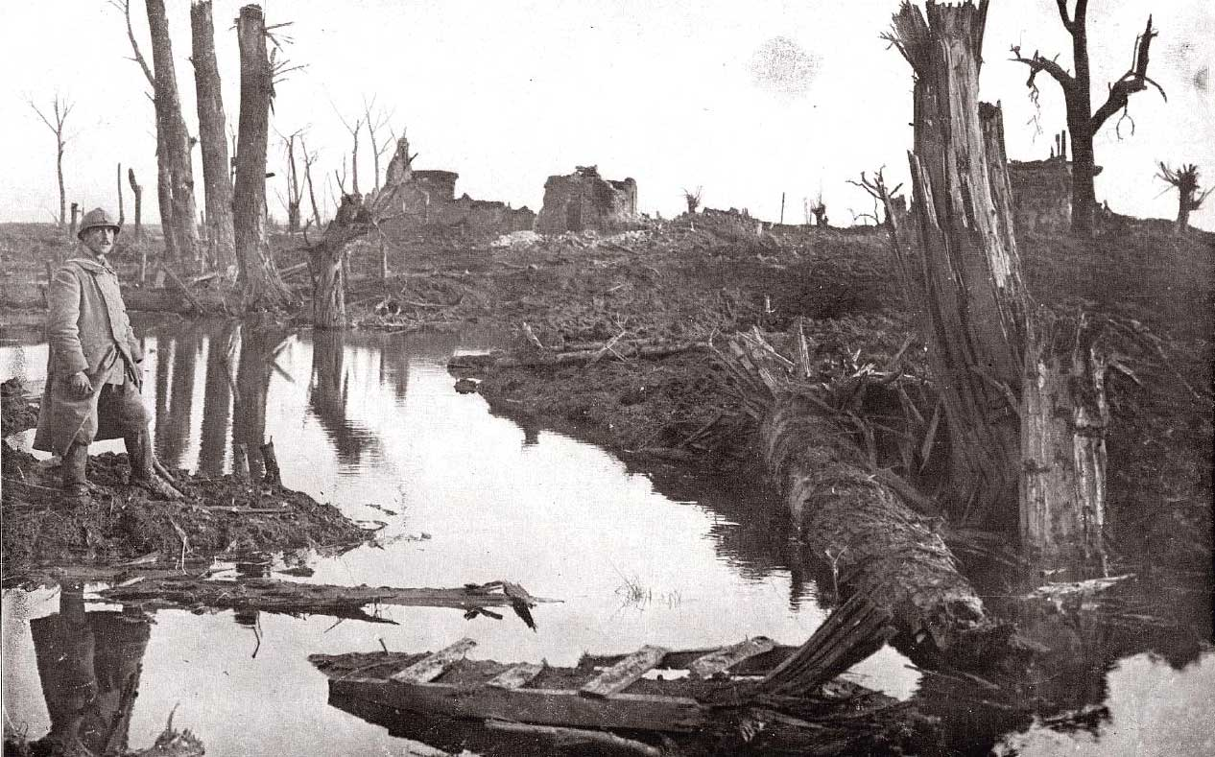
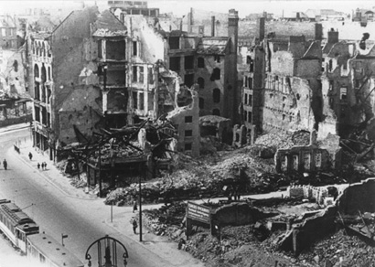
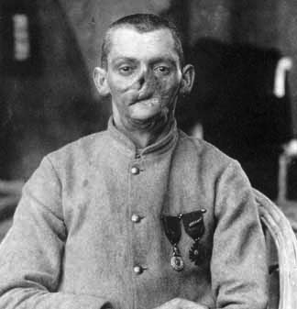
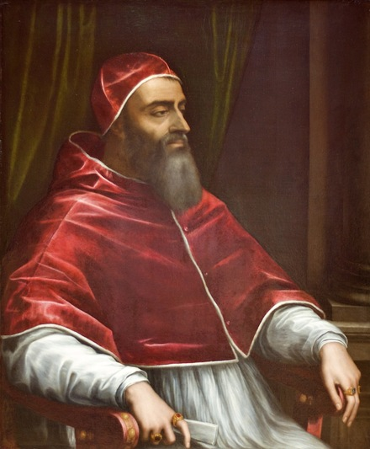
Project Introduction
The horrors of war stagger the imagination.
Cost to soldiers & civilians, countries & countryside give ample reason to study this phenomenon.
Poli scis tend, however, to talk primarily about war initiation, not who wins & why.
Practice of war is often seen as being too serious for academics (‘leave to diplomats & generals’).
Pope Clement: the “work of academics [dottori]…with their excessive subtleties…is more likely to ruin… than bring a good conclusion.”
Notes:
Third Ypres?
Fort Douaumont
Berlin ’45
French victim WWI.

Slide 3
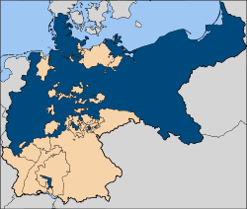
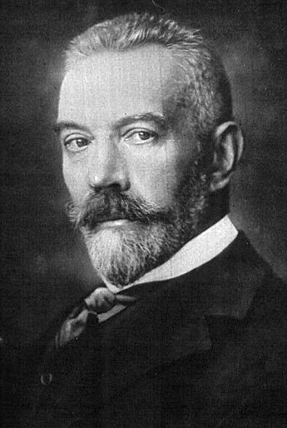
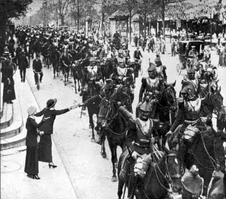
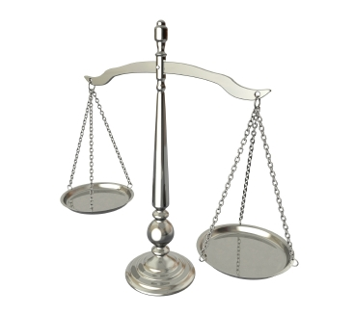
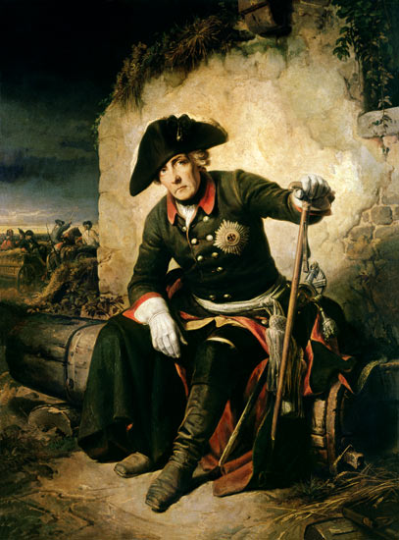
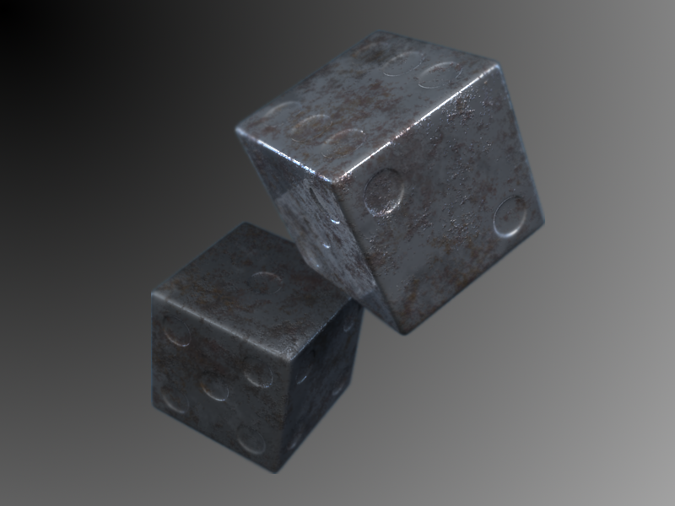
A Useful Conversation to Have
Argmt: is actually quite useful for us to consider military victory.
Is central to the story of any political unit (i.e. borders & survival).
Understanding is necessary to end the ‘rolling of iron dice’.
Theory & tests help check tendency to ‘let slip the dogs of war’ & leave outcomes to higher power.
Ignorance leads to abdication of responsibility.
Notes:
Rise of Prussia and Frederick the Great.

Slide 4
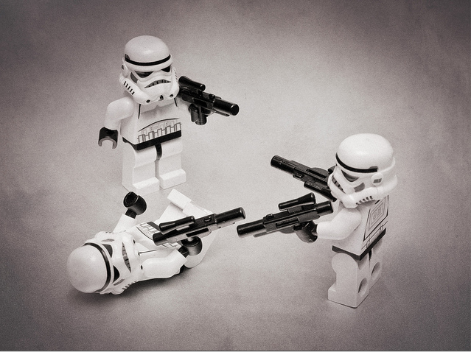
Project Niche
Are specific gaps in war studies literature itself.
1. Evidence used by current theories is often not as broad as their claims.
Generally restrict data to the modern era (i.e. Kugler, Organski).
Partly because of lack of accessible battle data.
Job here is thus as much a matter of empirical work as that of theoretical.
2. Theoretical: three theories, little agreement.
Notes:
http://www.flickr.com/photos/mister-mac/6808662449/

Slide 5
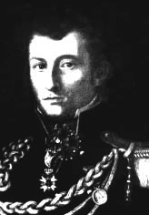
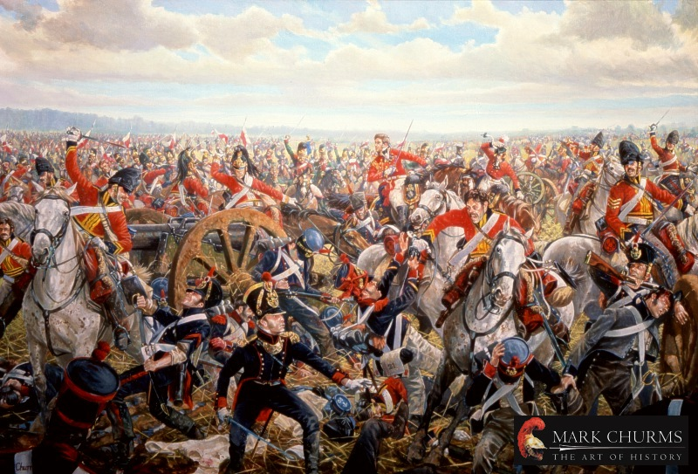
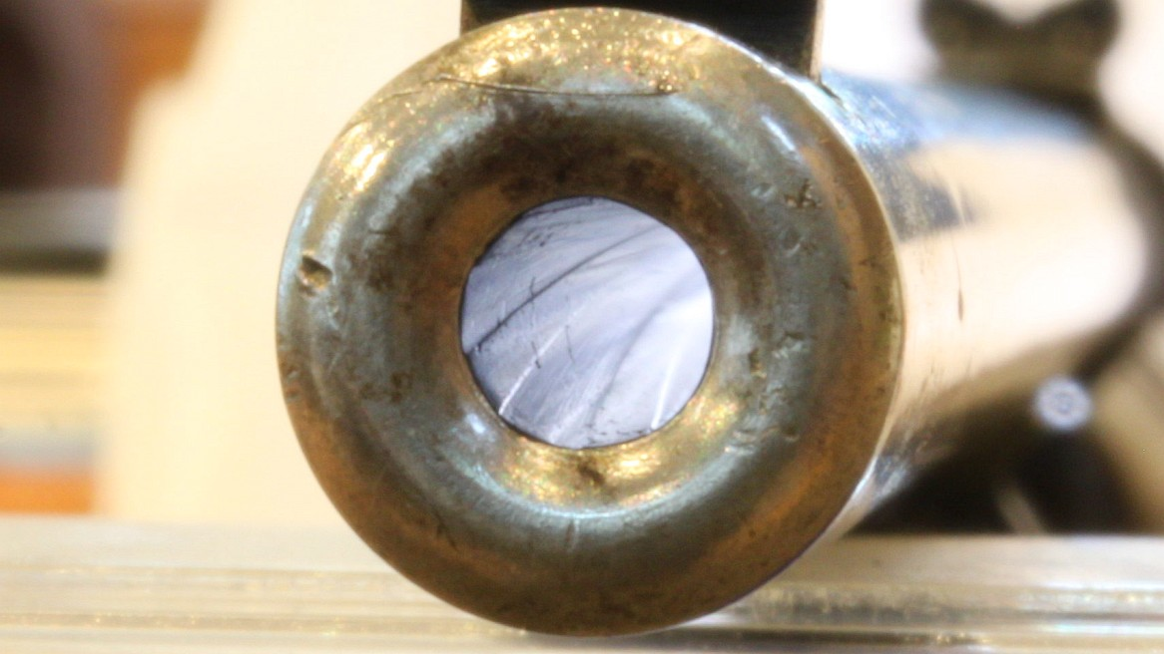
Methodological Approach
Why battles?
1. Methodological reason: data is more complete & easier to count than wars.
2. Theoretical: political aspect of war is demonstrated thru physical control of territory.
Clausewitz: battles are where violence is used “to compel our opponent to fulfill our will.”
Notes:
French & British at Waterloo.
End of rifle.

Slide 6
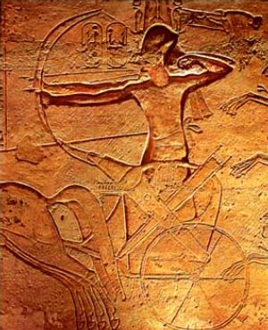
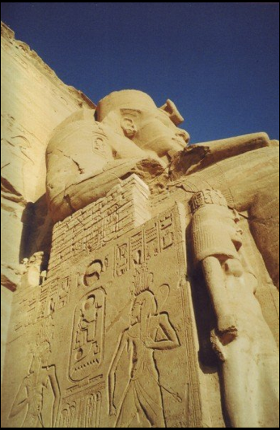
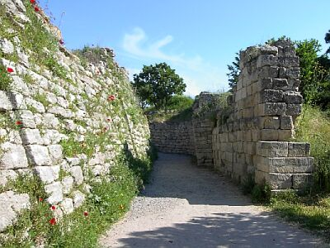
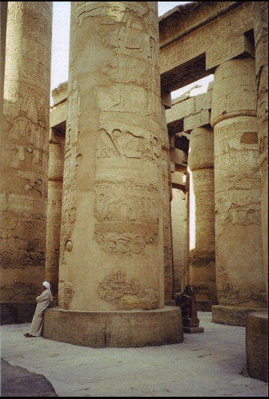
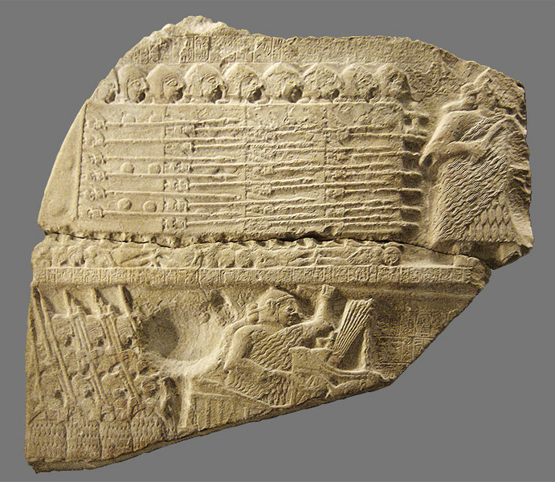
The Evidence
Deployment & casualty figures generally taken from archeology & written records.
Are imperfect resources, but can apply correctives (i.e. personal inspection, re-enactments, & biogeography) & end up with relatively reliable figures.
Notes:
Ramses II at Kadesh.
Battle formations on a fragment of the Stele of Vultures.: (Sumerian epoch).
The title page of Justus Lipsius's 1598 edition of the complete works of Tacitus, bearing the stamps of the Bibliotheca Comunale in Empoli, Italy.

Slide 7
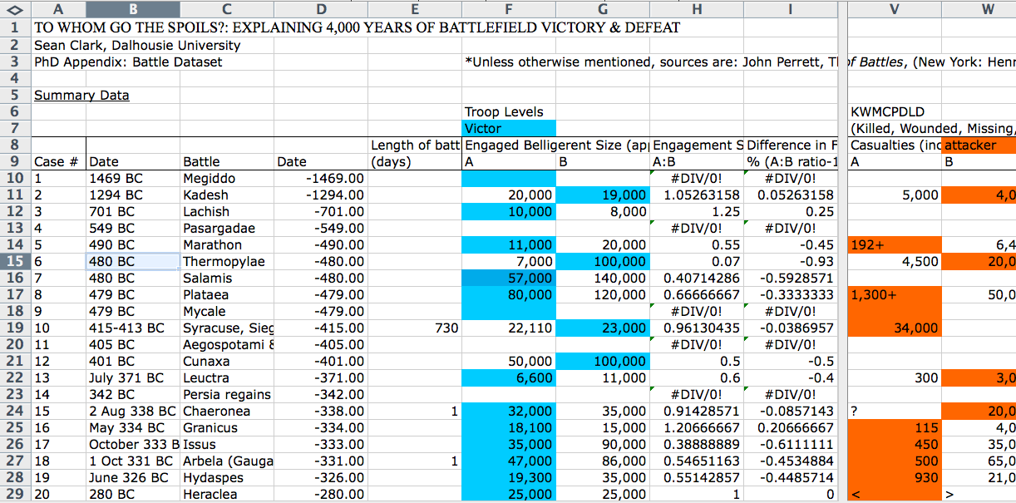
Dataset Construction
An entirely new dataset was created for this project.
Perrett, followed by Chandler, Badsey, Clodfelter relied on for battle statistics.
Conflicts resolved by more common figure.
754 battles incorporated, ranging from Megiddo (1479 BC) to Wanat (2008).
All data available at http://web.me.com/sean_m_c/Site/Academic_Details.html.

Slide 8
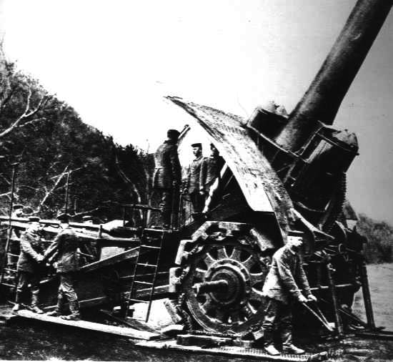
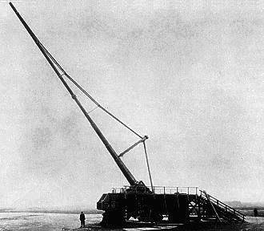
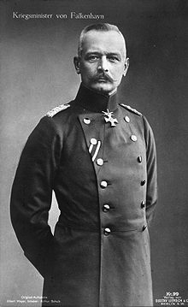
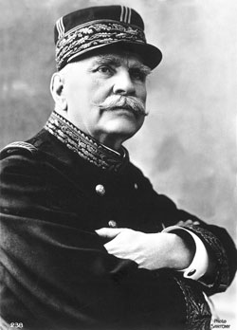
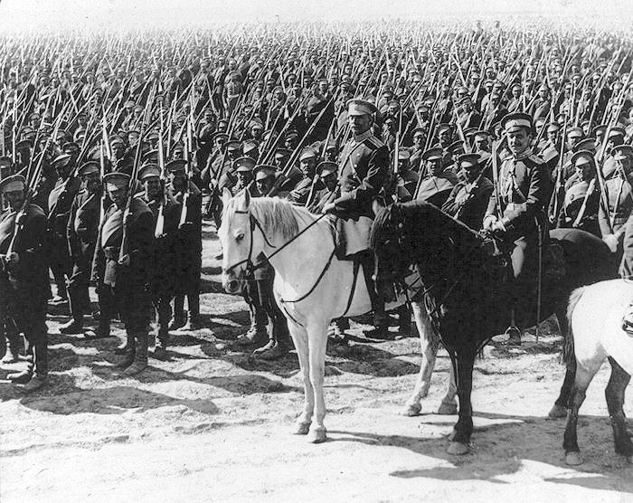
1. Preponderance Theory
Material superiority leads to victory.
Napoleon: “God is on the side of the big battalions.”
Biddle: “states with larger populations, larger or more industrialized economies, larger militaries, or greater military expenditures should prevail in battle.”
Conceive military operations as a series of “grinding, attritional struggles.”
Winner has enough mass to be last one standing.
Notes:
Falkenhayn. Joffre.
Big Bertha WWI.
Russian Army WWI.
Paris gun. Could shell Paris from 120km away.

Slide 9
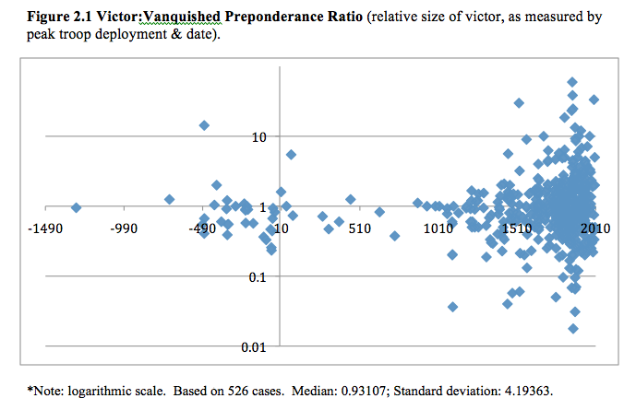
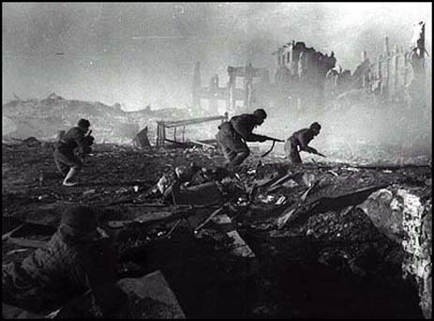
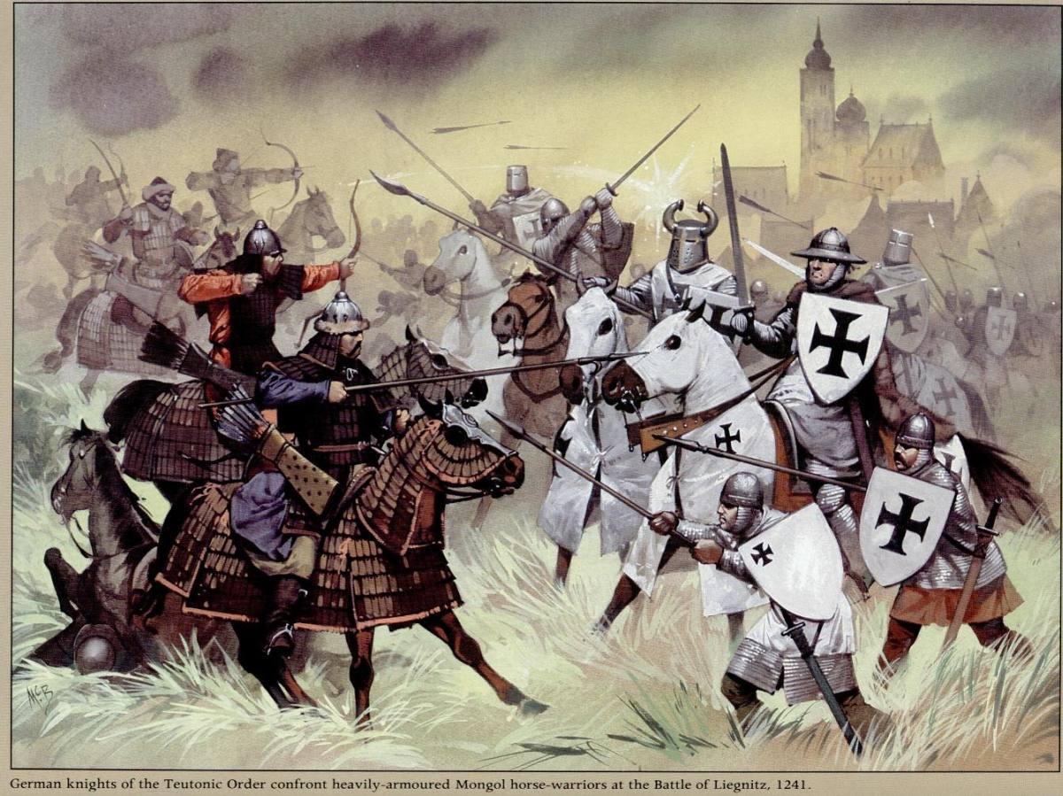
The Problem with Preponderance
Easiest measure is troop size.
Yet throughout history, larger size won only 45.4% of the time. Dreadful!
Victor-vanquished scatterplot reinforces the ambiguity.
Expect plots to be above the line—i.e. victor’s size > loser’s.
Yet just as many below lines of equality as above (inferior size often wins).
Notes:
For every Soviet force at Stalingrad (1942), there exists a case representing the opposite dynamic, such as Yellow River (1226), where an army numerically inferior nevertheless defeated its opponent. In the latter case, no more than 180,000 Mongol troops proved sufficient to utterly destroy the 300,000-strong Hsia army that stood in its way to southern China. Mongols fighting the
Teutonic Order at B of Liegnitz, 1241.
I.e. Kadesh (1294 BC): victorious Hittites outnumbered by Egyptian foes by 19,000 troops to 20,000, thus ratio = 0.95 (<1 = numerically inferior won).

Slide 10
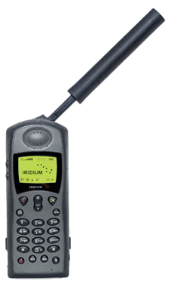
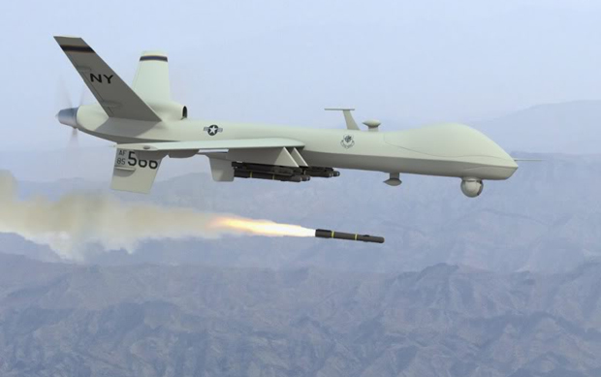
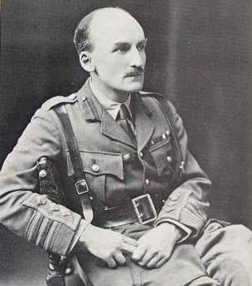
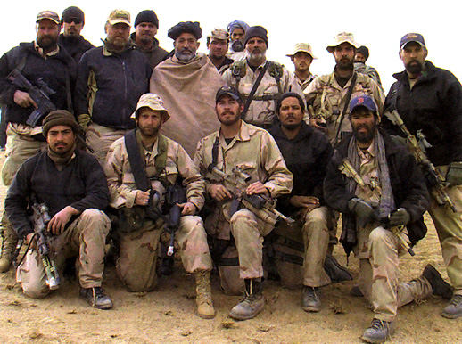
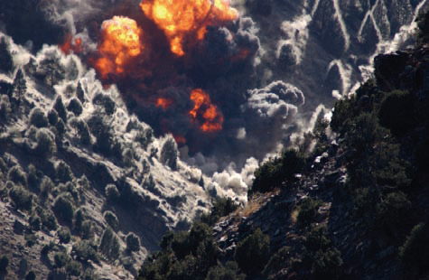
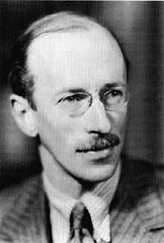
2. Technology Theory
Argmt: advanced weaponry will “always overcome…generals of genius.” (Friedrich Engels)
“Tools, or weapons, if only the right ones can be discovered, form 99 per cent of victory.” (J.F.C. Fuller)
Popularity reached height with 2001 Afghanistan invasion.
Notes:
Army Special Forces with Hamid Karzai in Kandahar province
Air strike on Tora Bora.

Slide 11
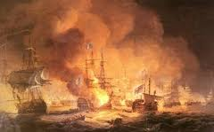
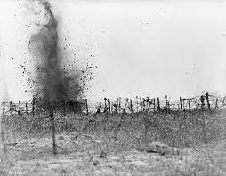
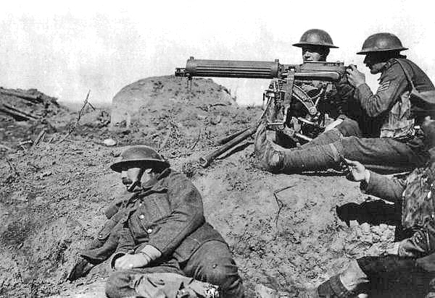
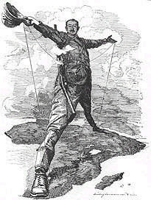
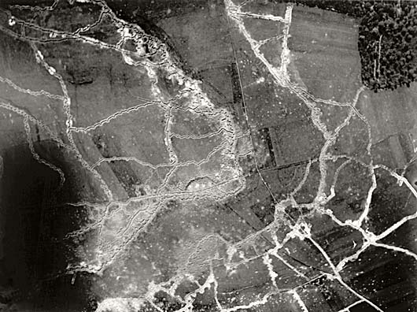
The Literature
Two versions:
1. ‘Systemic theory’: victory goes to the strategic posture (whether offensive or defensive) favoured by the technological conditions of the day.
Also known ‘offence-defence’ theory.
I.e. era of tanks & artillery will favour all attackers, system-wide.
2. ‘Dyadic theory’: technologically superior of two belligerents will invariably emerge the winner.
Notes:
Battle of Abukir bay (BofNile).

Slide 12
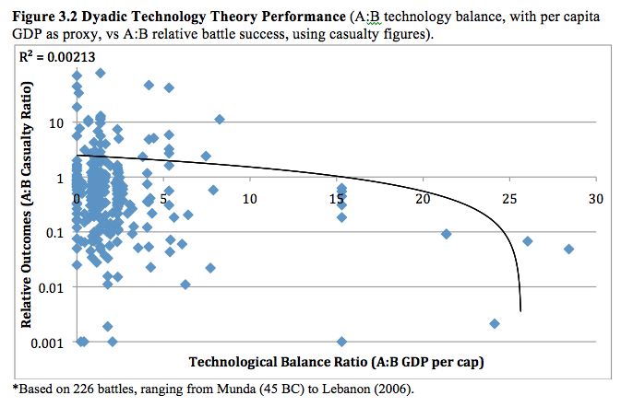
Returns to Dyadic Superiority
Best way to measure technology balance: per cap GDP.
In historical aggregate, superior have won only 63% of time.
Victory only certain, however, when disparity is massive.

Slide 13
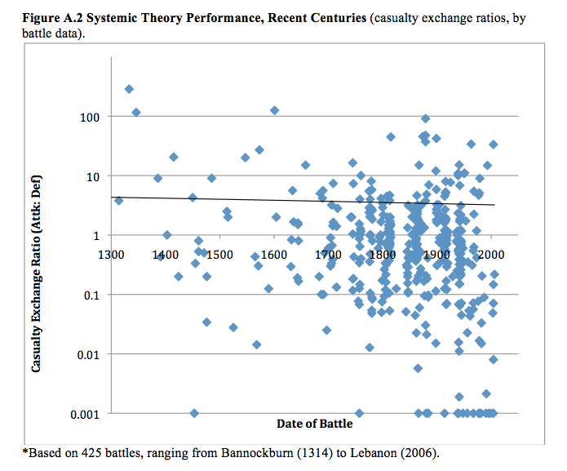
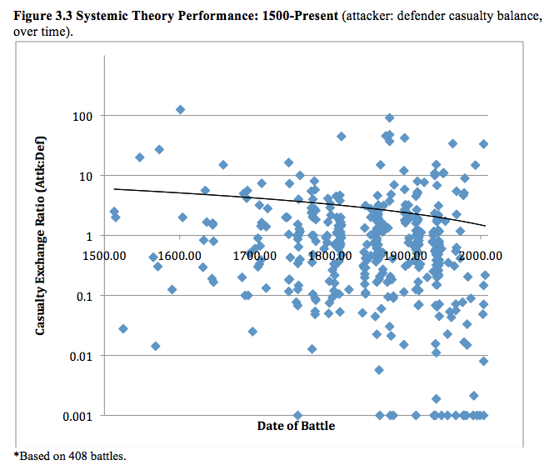
Results for Systemic Theory
Returns to force posture are terrible inconsistent.
Lack of ‘epochal stability’ (attackers & defenders not uniformly favoured) means technology cannot be decisive in its effect.

Slide 14
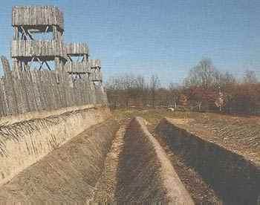
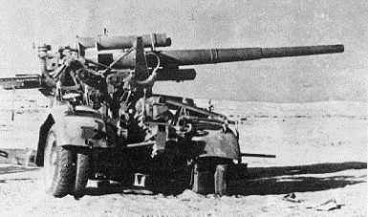
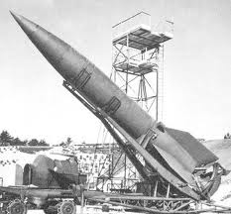
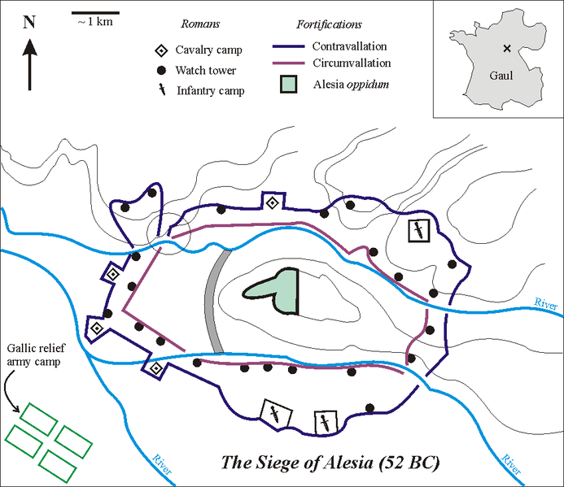
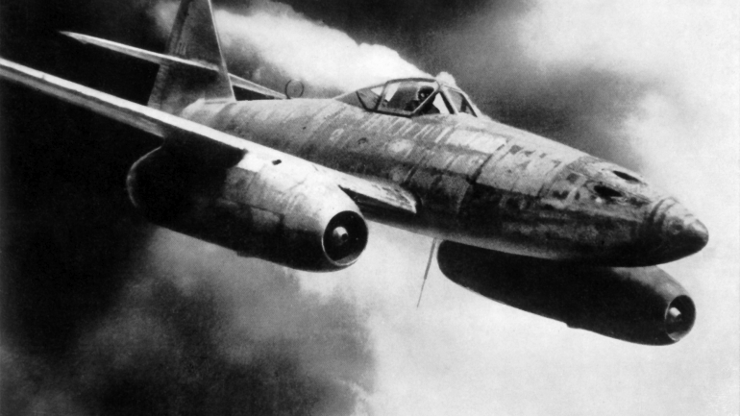
III. Proficiency Theory
Argmt: “good men with poor ships are better than poor men with good ships.” (Mahan)
Other theories are wrong: technology can be confounded and superior numbers outmaneuvered.
Victory instead reflects how well military forces put these material underpinnings, through tactics and strategy, training & motivation, to good effect.
Notes:
German 88. Me 262. V2

Slide 15
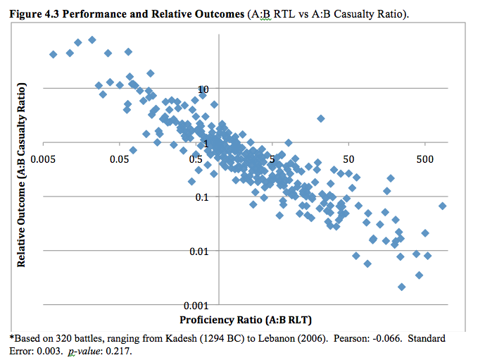
Returns to Proficiency
j

Slide 16
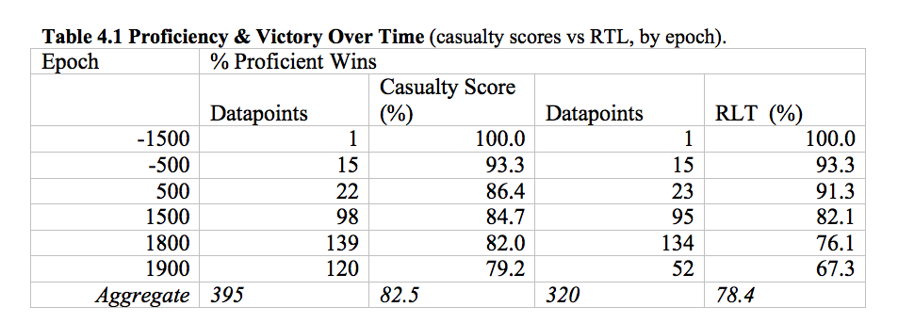
Returns to Proficiency
In aggregate, 78.4% of battles won by the more capable.
Great success!
Yet note of caution: RLT performance demonstrates a modest, albeit consistent, decline over time (i.e. 20thC is just 67% return).
Proficient are not as favoured as they once were.

Slide 17
Proficiency Erosion
Most persuasive explanation for this decline is ‘proficiency erosion.’
Against a tenacious, overwhelmingly preponderant adversary, even the most gifted militaries can be driven to exhaustion.
I.e. Greeks at Thermopylae (480 BC), French at Paris (1814), & Finns at Mannerheim Line (1940). Wehrmacht ground to dust vs Soviets.

Slide 18
The Uniqueness of Modern Times
Is possible that proficiency’s role has diminished in recent centuries bc grinding attrition has had more opportunity to take effect.
Premodern struggles: a few pitched battles, followed by swift capitulation or parades through conquered territory.
Following his bloody defeat at Marathon (490 BC), Darius I simply turned around and went home.
In contrast: technology & industr rev (& thus social organization) = battles long, drawn-out affairs.
By WWI: fight for months on end. Russo-German ‘41-45 war virtually without respite.
➔ Consequence is attrition given much more opportunity to act than battles of annihilation (i.e. Delbruck’s phrase).

Slide 20
Proficiency & Preponderance
How does preponderance impact proficiency?
1. Enjoying both superior numbers and more expert skill is virtually unbeatable.
90 instances in the dataset. In 93% (84 of 90), combination resulted in victory.
2. When a belligerent enjoys either preponderance or superior proficiency, but not both, superior proficiency wins 75% (of 249 cases).
It takes on average a massive level of preponderance to offset inferior proficiency (2.7x).
Notes:
B of Liayong. Japanese general and his chief of staff.
Cassino (1944)

Slide 21
Conclusions
Reliance on preponderance is murderously foolhardy.
Is the antithesis of strategy to assume numbers will win out.
Technology brings no salvation.
Victory relies on tactics, not gizmos.
Yet proficiency is no panacea, either.
Even the most vaunted armies can be ground down to young boys & old men.
Notes:
Soviet tanks.
Canadian army during 100 days.

Slide 22
A Final Warning
Proficient are not invincible.
Caesar in Britain, Norse in North America, British at Islandwana (1879), Germans at Caen (1944) have all been defeated by the less talented.
Wanat 2008: Taliban force 3x size came tantalizingly close to winning.
Perimeter breached; 9 of 45 Americans killed.
The West should therefore never take their proficiency for granted. To do so would be most dangerous.
Notes:
Islandwana a year later.
Little Big Horn.

Slide 24
Extra Slides

Slide 25
Arc of the Presentation
1. Project rationale.
2. Methodology.
Why battles?
How reliable are historical statistics?
3. Theories & Findings.
A. Preponderance theory.
B. Technology theory.
C. Proficiency theory.
4. Implications.

Slide 26
Problematic Theories
2. Theoretical.
Preponderance & technology arguments are antithetical.
If one is right, the other cannot be.
Proficiency.
Historians focus on cases, not general theory.
Gifted militaries are often overshadowed by greater numbers.
German ‘genius for war’ did not save them in WWI and WWII.
Notes:
Harrison GDP.
German July 1944 POWs in Moscow.

Slide 27
Technology, II.
Problem: unravels upon closer examination.
Massive swings w little (technological) reason.
Great War: movement to offence before tanks & radios became of real use.
Kaiserschlachten didn’t require either (about tactics).

Slide 28
“I have fought a sufficient number of battles to know that the result is never certain, even with the best arrangements.”
Wellington

Slide 29
“At Verdun, the combatant fought…in a landscape dismembered by explosives…[where] it was impossible to tell French from German; all were the color of soil.”
Eric Leed
“Only the dead have seen the end of war.”
Plato

Slide 30
The Reliability of Historical Statistics
How reliable are historical statistics?
Deployment & casualty figures generally taken from archeology & written records.
Archeological remains offer a degree of personal impartiality (i.e. garbage at Alexandria not discarded with an eye to future biographers. ).
Prob: artifact survival is generally capricious. Battle remnants are sporadic & imprecise clues (i.e. more remains of encampments than battle sites).
Fill in the missing details w literary accounts of contemporaries.
I.e. Thucydides, Polybius, Livy, Plutarch, & Caesar (via Arabs).
Prob: sometimes accounts are written entire centuries after the fact. Even when contemporaries observe an event first-hand, the fog of war can obfuscate the true meaning of what they are witnessing. Or self-aggrandize (Caesar planned to cross Rubicon).
→ These figures are highly imperfect.
Clodfelter (2009): “But for all my efforts at cutting through the exaggeration, propaganda, and outright mendacity with which the statics of warfare are weighted, it must still be admitted that every quantity in the work may legitimately be questioned.”
However, Delbrück (1920) and Whatley (1964): are a series of scholarly techniques that can improve our confidence in the ancient material:
Personal inspection of battlefield geography (give sense of what was possible, i.e. Thermopylae, El Alamein).
Battlefield re-enactments (physical & tabletop/numerical—ever increasing in popularity).
Biogeography: are certain limits to how large the population of an agrarian society can grow, and how many soldiers then can mobilize.
Richardson: “Although the numerical estimates obtained in this way are generally of very poor quality by the standards of experimental physics, yet they are sufficiently definite for the purpose of analysis applied to totals over a century.”
Accurate enough to get a sense of who was bigger, rough total size, what levels of casualties, & in what proportion.
Besides, think of how speed of light since 1600s. Have to start somewhere.

Slide 31
Picture of Assyrian siege engine.
Inscriptions at Karnak (my picture).
Troy.
Notes:
Karnak and Abu Simbel.
Portion of the legendary walls of Troy (VII), identified as the site of the Trojan War (ca. 1200 BC)
Assyrian siege engine.

Slide 32
h

Slide 34
Preponderance Results
H(P)1 (‘troop preponderance’)--is oldest version.
618 cases had sufficient data. In only 287 battles did the larger army (45.4%).
Potential for a historical skew in the data, thus broke down by epoch.
Only in 20thC did returns break even (56.4%).
➔ Numerical supremacy is thus no more predictive than a coin toss.

Slide 35
The Economic Alternative
H(P)2a (‘economic preponderance’: population).
Of 633 available battles, 336 cases confirmed the preponderance hypothesis (53.1%).
When broken into epochs, utility of wealth has been much more variable.
Favourability rises & falls in two distinct waves (peak in imperial/medieval & 20thC: 62% & 59%).
Variability is indicative of some exogenous force as the ultimate cause.
Nowhere in the logic of attrition is there the suggestion that it should operate more effectively in some circumstances than others.

Slide 36
lk

Slide 37
The GDP Measure
H(P)2b (‘economic preponderance’: GDP).
Industrial revolution in late 18th and early 19th centuries enabled economic growth to outpace population growth for the first time.
Fortunately, GDP estimates now available.
Of 409 battles (most post-1820), 254 cases (62.1%) confirmed preponderance hypothesis.
Overall findings: much improved—but 62% odds is still not enough for general to sleep soundly.
Exception: remarkable causal efficacy of post-war, pre-9/11 era (85%).

Slide 39
Operation Judgement
‘Bleeding the French white.’
“The French, forced to fight in a crucial but narrowly constricted corner of the Western Front, would be compelled to feed reinforcements into a battle of attrition where the material circumstances so favoured the Germans that defeat was inevitable. If the French gave up the struggle, they would lose Verdun; if they persisted, they would lose their army.”
Powerpoint picture of Verdun

Slide 40
Regardless of the Futility
Britain takes French model, & tries own hand at the Somme.

Slide 41
Testing Systematic Theory
Divide each set of chronological intervals in decreasing historical breadth as they get closer to the present.
-500 BC to 1500 AD: 500-year intervals:
Weapons of Romans hardly improved until Renaissance.
1300-present: 100-year intervals:
Good enough for Addington’s ‘patterns’. I.e. took 200yrs for guns to be practical.
1700-present: ~25-year intervals.
Available from 1700 onwards. Useful for when the pace of technological innovation soared to new heights.
Can also compare returns to strategic posture against the predictions offered by others in the literature.
I.e. 1900-24 as dominated by the machine gun, barbed wire, and long-range artillery, and thus extremely favourable to defence.
Next fifty years, dominated as they were by the tank, the airplane, and the radio (which appeared in the second, but matured in the third), were much more conducive to the attack—particularly in the latter period.
1975-00: proliferation of precision-guided antitank and anti-aircraft missiles = defence.
Results must indicate a sharp bias in the returns to either offence or defence, & that this skew coincides with the posture presumed to be dominant at the time.
Looking for:
1. Frequency of attacker success.
Consistently in either direction suggests strong effect that would expect w technology theory.
2. Attacker performance.
Based on casualty loss rates (not perfect dep var, but close. & is necessary ratio form).
‘Attacker’ as defined by geography. (when uncertain, rely on strategic intent).
I.e. COW; Arquilla.

Slide 42
Notes:
From Cipolla, Before, p236

Slide 43
Technology Gap, by Date

Slide 44
Systemic Theory Results
Prediction: a series of distinct oscillations between offensive and defensive success.
Define ‘high’ & ‘low’ rates of success w comparison to mean of the aggregate sample (61.8%).
5% above (67%) is clearly favourable to offence, 5% below to defence (57%).
500-year intervals: -500 BC to 1500 AD.
Data seems to coincide w historiography of the time.
Lots of attacker in success in early imperial age; little in dark ages.
Prob: other two epochs not clearly biased towards one posture or another.
Why is force posture favoured in some epochs (as theory predicts) and not others? Must be some extraneous variable at play.
100-years intervals: 1300 to 2006.
With Renaissance, pace of change quickens (thus shrink intervals—plus have data to do so).
Prob: performance is just as weak. Half of epochs remain close to historical average.
Only 1500s & (small-sampled) 2000s overwhelming in their posture advantage.
➔ Concl: technological conditions do not shift decisively, as technology theory predicts.
Does not speak well for the predictive power of systemic technology theory.
Now with sufficient data, can use a scatterplot to track attacker-defender performance ratios over time.
Expectation is that the plots should cluster together in any given epoch (looking for consistent rates of performance).
Prob: they do not. Outside early imperial epoch, no sign of clustering. Returns to posture seem randomly distributed.

Slide 45
a

Slide 46
j

Slide 47
Systemic Theory Results, II
Alternative periodizations.
Have sufficient data to break into ~25-yr periods for recent centuries.
Can match these with some of the leading periodizations found in the systemic technology literature.
Using historical average (62%) +/-5% again as benchmark, can see how predictions hold up.
Prob: results similarly disappointing.
Most tend to hover around 60% rate, indicating little strong bias towards either force posture.
Worse: some strong findings were wrong posture.
I.e. 1975-’00 supposedly defensive, yet attacker won 84% of time.

Slide 48
b

Slide 49
Results for Systemic Theory
Expect ‘epochal stability’.
If tech favours offence, attackers should win w consistency for that period.
Prob: attacker success rarely departs from near historical average (62%).

Slide 50
a

Slide 51
j

Slide 52
Why Do the Gifted Lose?
1. Perhaps proficiency’s importance is declining bc there are fewer ‘bad’ armies.
Diffusion of Kriegsakademie model is near-universal. Talent is cultivated.
If no longer a clear divide between the capable and the incompetent, expect proficient to have a less easy time.
Notes:
Kerensky. Julian Byng. Hindenburg and Ludendorff.

Slide 53
Yet No End to the Blunderers
k

Slide 54
The Ubiquity of Proficiency Erosion
Is not, however, a dynamic totally constrained to modern times.
Are many instances of drawn-out struggles were erosion can be found.
I.e. Hannibal, Napoleon, and Lee.
Confederates: average combat effectiveness 1.7x > North. Yet by end, i.e. Five Forks (1865) and Appotomax (1865), exhaustion = manages no more than 38% of the North’s performance.
Sherman’s ‘march to the sea’ had a tremendous impact on ability to survive.
Napoleon: Ulm (1805) and Austerlitz (1805): French effectiveness almost 3.5x >. Yet Wagram (1809): 1.5. Waterloo (1815): even.
New mass conscript armies just not as capable revolutionary/ancien regime hybrid.
Hannibal fared worst: from 7.7x > at Cannae (217 BC) to just 10% of Scipio’s forces at Zama (202 BC).
Too worn out from 15 years of constituent fighting to offer much of a resistance.

Slide 55
k

Slide 56
k

Slide 57
Campaigns & Single Engagements
Proficiency erosion is generally felt after a series of engagements.
But it can also be at play within a specific engagement itself, so long as the discrepancy in numbers is sufficiently large and the battles last long enough for attrition to perform its deadly work.
See frequently in imperial battles: i.e. Islandwana (1879); Caesar in Britain, the Norse in North America, & the Tuareg of the Sahara in the 1890s.
➔ Historical lesson: while proficiency matters most, it is not everything.

Slide 58
The Uniqueness of Modern Times
Possible that proficiency’s role has diminished in recent centuries bc grinding attrition has had more opportunity to take effect.
Premodern struggles: a few pitched battles, followed by swift capitulation or parades through conquered territory.
Today: technology & industr rev = battles long, drawn-out affairs.
➔ Consequence is attrition given much more opportunity to act than battles of annihilation.
Notes:
Kursk.
Passchendaele.

Slide 59
Longer Struggles
j

Slide 60
Proficiency in the 20th Century
Proficiency can be eroded in any epoch.
Comes a point when any army, no matter how gifted, can no longer bear the weight of numbers against it.
Chance increases when political, economic, and social conditions permit the mobilization of resources on industrial scale.
Struggles w levee en masse & incessant war production are less about singular contests—where skill can prevail prior to exhaustion setting in—than drawn-out campaigns, where proficiency is ground down by the unceasing nature of industrial war.
Longer a battle lasts, the more opportunities for the materially preponderant to bring their capital resources (such as tanks and guns) to bear on an opponent, all while the proficient have little chance to recover from the steady drain.
I.e. shuttling German divs at end of WWII less-suited to meatgrinder than Sovs.
In contrast, pauses in preindustrial wars favour the proficient and disadvantage the preponderant.
Granicus (334 BC) and Gaugamela (331 BC) were titanic and bloody, yet relatively discrete.
This afforded the Greek pikemen and cavalry time to rest and recuperate in preparation for the next battle.
Plus, passage of months between battles did little to change the material balance between armies (light infantry called to colours quickly, but then slow).
Time allows the wounded to heal & exhausted to rest, yet adds fresh troops only as fast as conscript classes reach maturity and fresh allies are secured.

Slide 62
k

Slide 63
Notes:
Napoleon crossing the Alps.
Mongols fighting the Teutonic Order at B of Liegnitz, 1241.
Aftermath of Manzikert. [incompetence matters]
Huey UH-1D helicopters in Vietnam, 1966. UH-1D helicopters airlift members of the 2nd Battalion, 14th Infantry Regiment from the Filhol Rubber Plantation area to a new staging area, during Operation "Wahiawa," a search and destroy mission conducted by the 25th Infantry Division, northeast of Cu Chi, 1966. US Archiv ARCWEB ARC Identifier: 530610Date1966AuthorJames K. F. Dung, SFC, Photographer.
A precision air strike takes out an insurgent stronghold as Marines with 3rd Battalion, 1st Marine Regiment, 1st Marine Division, move forward through the city of Fallujah, Iraq, November 10, 2004. Photo credit: DoD photo by Lance Cpl. Thomas D. Hudzinski, U.S. Marine Corps. Presented by USCENTCOM
Morella paintings. Early Neolithic. (white picture)

Slide 64
Inadequacies Abound
Methodological.
1. Lack breadth of cases (narrow sample).
Kugler & Domke (‘86) end at 1904.
Organski & Kugler (‘81) end at 1860.
2. Unsystematic.
Some travel far back in time, yet do so haphazardly.
Ie Gilpin (‘81), Copeland (‘00), Doran (‘03).
==> often predicated on lack of aggregated data.
Theoretical.
Preponderance & Technology are antithetical.
#s do not matter if offensive tech reigns supreme.
Proficiency
Historians focus on cases, not general theory.
Gifted militaries are often overshadowed by >er #s (ie Germany in WWI & WWII).
Notes:
French and British at Waterloo.

Slide 65
Inadequacies, II
Empirical.
Preponderance.
1900-92: preponderance wins only 62% of time.
Nor is it any help to battlefield performance.
Technology.
Tech has only improved, while mobility has languished.
Tanks can reach highway speeds, yet get only 4km/day on battlefield.
20thC: shifts in prevailing tech not helped attacker until last 1/4 century.
1900-1974: odds of attacker victory stayed at 2/3, despite tank, airplane, & wireless.
1956-1992: only 8 of 16 wars won by side w newer weapons.

Slide 66
Inadequacies, III
Empirical (cont).
Proficiency
Lose forest from the trees.
How test Biddle’s (‘05) 24 hypotheses across time?
Systematic examinations of proficiency’s contribution to victory are historically narrow.
Notes:
Rock carving from Bronze Age.
The Somme.

Slide 67
Methodology, II
Key concepts:
Preponderance: more troops.
Casualties: incl POWs, where available (though % also provided).
Attacker: moves first. When doubt, strategic initiative.
Victory: blinks last (who left the field last?).
Casualty Score: Cas: B/A, Cas; A/B
(casualties A inflicts on B, per casualty of their own endured).
[is about balance of casualties].
Relative Kill Totals (RKT):
A: Bcas/Aengaged, B: Acas/Bengaged
(casualties A inflicts on B, per soldier of A engaged).
[is about relative combat performance].

Slide 68
Results
1. Frequency.
No civilization = no war (though was lots of violence).
Campaign initiation follows the weather.
Recent growth in battles per century & per year.
More actors, more records, higher intensity.

Slide 70
2. Intensity.
Antiquity unmatched until relatively recent times.
Dark Ages: smaller forces & fewer casualties.
Modernity = entirely new era.
Unprecedented peak & average engagement size.

Slide 71
h

Slide 72
Modernity = incredible industrialization of war.
Ie 2,000 guns at Leipzig (1813) vs 38,600 at Bagration (1944).

Slide 73
Results, II
Theories of Victory.
Preponderance.
Problem: theory is no more predictive than a coin toss.

Slide 74
Preponderance, cont.
Epoch breakdown is of little help.
(some fare even worse than coin flip).

Slide 75
Preponderance, cont.
Different proxy, same result.
(guns, as metric for relative industrialization).

Slide 76
Technology
If true, either attacker or defender must be favoured over a stable period.
(is indirect evidence of underlying technological bias).
Evidence: attackers are favoured in some epochs.
Notes:
Krek de Chavaliers, Syria (completed 1140, home to 2,000 Hospitalers & 8,000 refuge peasants. Fell 1271).

Slide 77
Technology, II.
Problem: unravels upon closer examination.
Massive swings w little (technological) reason.
Great War: movement to offence before tanks & radios became of real use.
Kaiserschlachten didn’t require either (about tactics).

Slide 78
Proficiency
Appears superior combat ability generally = victory.
Even demanding RKT analysis enjoys 80% success.
(RKT takes into account numerical discrepancy, but requires more data).
Notes:
German forces during Operation Blue, Summer 1942 (would take them to the gates of Stalingrad).

Slide 79
Proficiency, II
Problems:
Poorly explains Modern epoch.
Germany outfought enemies in WWI & WWII, yet still lost battle after battle.
Notes:
Soviet soldiers fighting during the Battle of Stalingrad, 1942 - a turning point in the war (CGSC).

Slide 80
Conclusions
So what explains victory?
Outfighting is chief method to victory.
Yet must recognize numbers matter, too.
Proficiency erosion strikes even the most gifted.
Notes:
Harrison: GDP.
Soviet soldiers Mikhail Yegorov and Meliton Kantaria of the Soviet 756th Rifle Regiment raising the Soviet flag over the Reichstag during the Battle of Berlin on April 30, 1945. Soldiers raising the flag of Soviet Union on the roof of Reichstag building in Berlin, Germany in May, 1945. Тe flag was made from аred tablecloth with the hammer and sickle themselves stamped on. This is the original version of the famous picture seen on the right where a second wristwatch or a wrist compass is missing from the other Soviet soldier (possibly retouched on purpose because it was a stolen watch, see sources below). Photograph by Yevgeny Khaldei (1917-1997). Public Domain

Slide 81
Conclusions, II
1. Numbers & proficiency can work in conjunction.
Together, they are virtually unbeatable.
2. Numbers can, however, overcome proficiency.
Historical average: 2.7x does the trick.
Notes:
The battle at Isandhlwana, fought in January 1879, was an important battle in the Anglo-Zulu War. About 1,700 British soldiers were lost in the battle. This picture shows British soldiers at Isandhlwana later that year. Isandhlwana is now a historic site in the KwaZulu-Natal province of South Africa.

Slide 82
Conclusions
None of the theories is without flaw.

Slide 83
Technology, II.
Yet extremely difficult to untangle the evidence.
Technology or Hannibal = Punic victories?
How much better is one flintlock from another?
What of WWI’s defensive weapons?

Slide 84
Survive by spreading out.
Requires patriotism & technology (ie radios).

Slide 85
Problem: why this not reflect other total strength & total cas graph?

Slide 86
Frequency, cont.
General trend: more battles, but less war.
Leads to question of battle intensity.

Slide 87
Empirical Backdrop, I
Theoretical Lethality Index (theoretical kills, per hour; assorted weapons).
*Source: Dupuy ’95, p26-27.

Slide 88
Empirical Backdrop, II
Troop Dispersion Over Time (km2/ 100,000 soldiers).
*Source: Dupuy '95.

